Slide 1
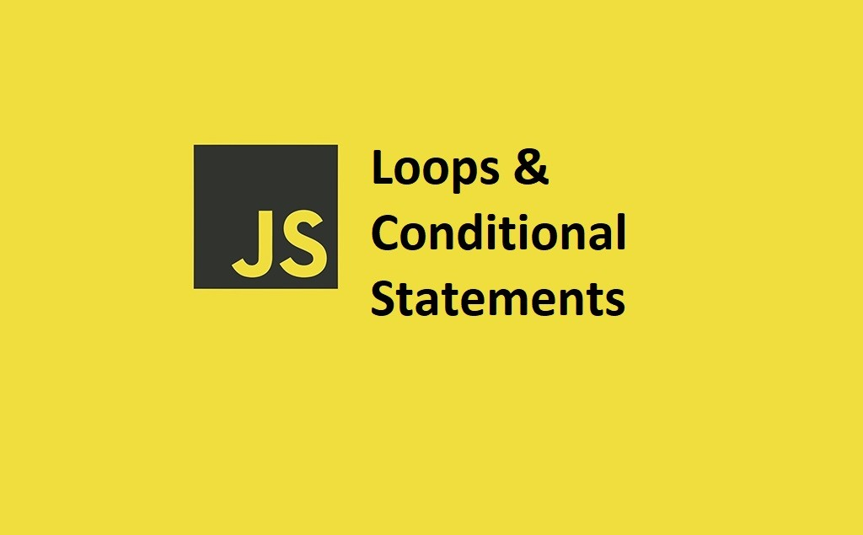

Slide 2
What we Cover Today:
01
02
03
04
05
The Conditional Ternary Operator
The Nullish Coalescing Operator (??)
The Logical OR (||)
Switch Statement
Exercise

Slide 3
The Conditional Ternary Operator
A short way to write an if...else.
Called ternary operator because it has 3 parts.
Uses ? and :.
Syntax
(condition) ? expression1 : expression2
Condition – a test (true or false)
expression1 – what to do if true
expression2 – what to do if false

Slide 4
The Conditional Ternary Operator
Example:
let age = 20;
let result = (age >= 18) ? "Adult" : "Child";
console.log(result); // "Adult"
Example 2:
let number = 7;
let type = (number % 2 === 0) ? "Even" : "Odd";
console.log(type); // "Odd"

Slide 5
The Nullish Coalescing Operator (??)
The ?? operator returns the first argument if it is not nullish (null or undefined).
Otherwise it returns the second argument.
Example:
let name = "" ?? "Guest";
console.log(name); // "" (keeps empty string)
let age = 0 ?? 18;
console.log(age); // 0 (keeps zero)
let city = null ?? "Hargeisa";
console.log(city); // "Hargeisa"

Slide 6
The Logical OR (||)
Checks left value.
If left is false → return right.
If left is true → return left.
False values in JS:
false, 0, "" (empty string), null, undefined, NaN.
Example:
let name = "" || "Guest";
console.log(name); // "Guest“
Example 2:
let age = 0 || 18;
console.log(age); // 18

Slide 7
Switch Statement
switch is often used as a more readable alternative to many if...else if...else statements, especially when dealing with multiple possible values.
Syntax
switch(expression) {
case x:
// code block
break;
case y:
// code block
break;
default:
// code block
}

Slide 8
Switch Statement
Example:
switch (new Date().getDay()) {
case 0:
day = "Sunday";
break;
case 1:
day = "Monday";
break;
case 2:
day = "Tuesday";
break;
case 3:
day = "Wednesday";
break;
case 4:
day = "Thursday";
break;
case 5:
day = "Friday";
break;
case 6:
day = "Saturday";
}

